Slide 1
HOWTO: Using WPF 4 (and .NET 4 in general) from a .NET 3.5 app

Slide 2
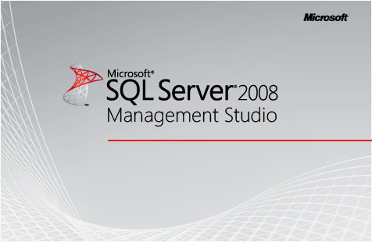

SSMS 2008

Slide 3


SSMS 2012

Slide 4
The error
15:18:11.749|Error |RedGate.SIPFramework|1 |Failed to load plugin
System.BadImageFormatException: Could not load file or assembly 'file:///C:\Program Files (x86)\Red Gate\Database Package SSMS Plugin 1\RedGate.Deploy.SqlServerDbPackage.SsmsPlugin.dll' or one of its dependencies. This assembly is built by a runtime newer than the currently loaded runtime and cannot be loaded.

Slide 5

The “solution”

Slide 6
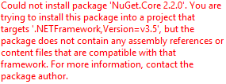
But…

Slide 7

The solution

Slide 8
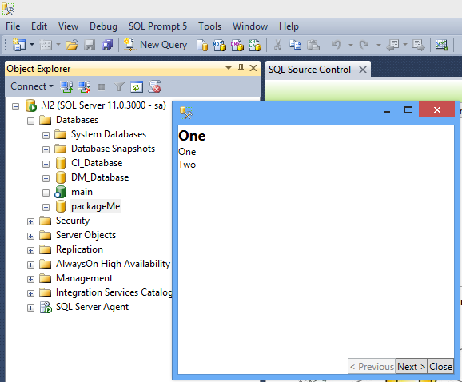
Ingeniously simple

Slide 9
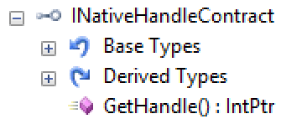
INativeHandleContract is your friend
FrameworkElementAdapters.ViewToContractAdapter
FrameworkElementAdapters.ContractToViewAdapter

Slide 10
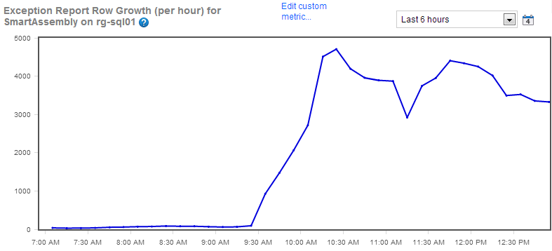
P.S.

